Slide 1

Chapter 2 Intelligent Agents
Source: Getty Images/iStockphoto

Slide 2
Outline
Agents and environments
Rationality
PEAS (Performance measure, Environment, Actuators, Sensors)
Environment types
Agent types

Slide 3
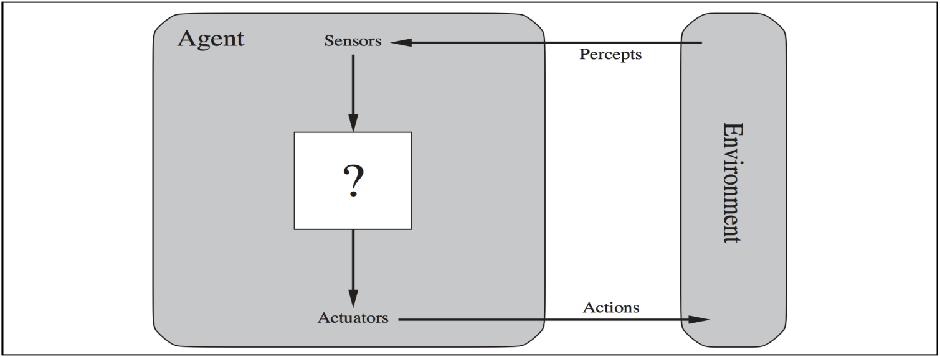
Agents
An agent is anything that can be viewed as perceiving its environment through sensors and acting upon that environment through actuators
Human agent: sensors - eyes, ears, and other sensory organs; actuators - hands, legs, mouth etc
Robotic agent: sensors - cameras and infrared range finders ; actuators - various motors for actuators
Software agent: sensors -
actuators -
Key strokes, file contents, network packets
Displaying on screen, writing files, sending network packets

Slide 4
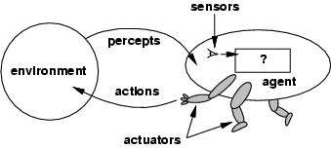
Agents
An agent is anything that can be viewed as perceiving its environment through sensors and acting upon that environment through actuators
Percepts: agents perceptual inputs at any given instance
Percept sequence: complete history of agents perceived inputs
Agent functions: describes the agent’s behavior
The agent function maps from percept histories to actions:
[f: P* → A]
The agent program runs on the physical architecture to produce f
agent = architecture + program

Slide 5
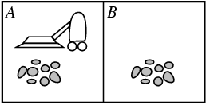
Vacuum-cleaner world
Percepts: location and contents, e.g., [A, Dirty]
Actions: Left, Right, Suck, NoOp

Slide 6
A vacuum-cleaner agent

Slide 7
Good behavior: Concept of Rationality
Rational agent
An agent should strive to "do the right thing", based on what it can perceive and the actions it can perform.
All entry in the table for the agent function are filled correctly.
The right action is the one that will cause the agent to be most successful
How to measure success????
Performance measure: A criterion for success of an agent's behavior
E.g., performance measure of vacuum cleaner
amount of dirt cleaned up,
amount of time taken,
amount of electricity consumed,
amount of noise generated, etc.
Selection of performance measure:
Average performance Vs energetic performance with long breaks
Reckless life or safe but simple existence
Economy with moderate poverty for all or some are super rich + some are very poor

Slide 8
Good behavior: Concept of Rationality
What is rational??
The Performance measure that defines the criterion of success
The agent’s prior knowledge of environment
The actions that the agent performs
The agent’s percept sequence to data
Def: For each possible percept sequence, a rational agent should select an action that is expected to maximize its performance measure, given the evidence provided by the percept sequence and whatever built-in knowledge the agent has.
How to check if Vacuum cleaner is a rational agent?
Performance measure: award one point for each clean square Environment: Geography of environment is known apriori – two squares A & B
Actions: Left, Right, Such and NoOp
Sensors: Agent perceives its location and checks if contains dirt or not
Under these circumstances Vacuum cleaner agent is rational.

Slide 9
Rational agents
Agents can perform actions in order to modify future percepts so as to obtain useful information - information gathering, exploration
An agent should learn from what it perceives
An agent is autonomous if its behavior is determined by its own experience (with ability to learn and adapt)

Slide 10
Nature of Environment
Building rational agents
Task environments : “problems”
Rational agent : “solutions”
Specifying task environment
PEAS: (Performance measure, Environment, Actuators, Sensors)
e.g., the task of designing an automated taxi driver:
Performance measure: Safe, fast, legal, comfortable trip, maximize profits
Environment: Roads, other traffic, pedestrians, customers
Actuators: Steering wheel, accelerator, brake, signal, horn
Sensors: Cameras, sonar, speedometer, GPS, odometer, engine sensors, keyboard

Slide 11
PEAS
Medical Diagnosis
Part-picking robot

Slide 12
PEAS
Agent: Medical diagnosis system
Performance measure: Healthy patient, minimize costs, lawsuits
Environment: Patient, hospital, staff
Actuators: Screen display (questions, tests, diagnoses, treatments, referrals)
Sensors: Keyboard (entry of symptoms, findings, patient's answers)
Agent: Part-picking robot
Performance measure: Percentage of parts in correct bins
Environment: Conveyor belt with parts, bins
Actuators: Jointed arm and hand
Sensors: Camera, joint angle sensors

Slide 13
Environment types
Fully observable vs. partially observable:
Fully observable - An agent's sensors give it access to the complete state of the environment at each point in time.
Sensors detect all aspects relevant to choice of action (performance measure)
Agent need not maintain any internal state to keep track of the world
Partially observable - due to noise or inaccurate sensors or parts of state are missing
E.g. taxi cannot what other drivers are thinking
Deterministic vs. stochastic:
Deterministic - The next state of the environment is completely determined by the current state and the action executed by the agent.
E.g. taxi driver is stochastic, vacuum cleaner example is deterministic
(If the environment is deterministic except for the actions of other agents, then the environment is strategic)
Episodic vs. sequential:
The agent's experience is divided into atomic "episodes"
each episode consists of the agent perceiving and then performing a single action, and the choice of action in each episode depends only on the episode itself.
In sequential environment, the current decision could affect all future decision
E.g chess playing , taxi driver – sequential
Fault detecting robot in assembly line - episodic

Slide 14
Environment types
Static vs. dynamic:
The environment is changed while an agent is deliberating – dynamic else static.
Static – easy to deal, no importance to time
(The environment is semi dynamic if the environment itself does not change with the passage of time but the agent's performance score does)
E.g. taxi – dynamic, crossword puzzle – static, chess with clock - semidynamic
Discrete vs. continuous:
Applied to state of environment, way time is handled, percepts/actions of agents
Discrete - A limited number of distinct, clearly defined percepts and actions.
E.g taxi – continuous ,
chess, crossword - discrete
Single agent vs. multi agent:
Single - An agent operating by itself in an environment
E.g. crossword - single
Competitive multiagent – chess with opponent
Cooperative multiagent – taxi driving

Slide 15
Environment types
 | Taxi driving | Chess playing with clock | Chess playing without clock
Observable | Partially | Fully | Fully
Deterministic | Stochastic | Strategic | Strategic
Episodic | Sequential | Sequential | Sequential
Static | Dynamic | Semi-dynamic | Dynamic
Discrete | Continuous | Discrete | Discrete
Agents | Multi | Single | Single
The real world is partially observable, stochastic, sequential, dynamic, continuous, multi-agent

Slide 16
Agent functions and programs
An agent is completely specified by the agent function mapping percept sequences to actions
One agent function (or a small equivalence class) is rational
Aim: find a way to implement the rational agent function concisely

Slide 17
Table-lookup agent
action ← LOOKUP( percepts, table)
Drawbacks:
Huge table
Take a long time to build the table
No autonomy
Even with learning, need a long time to learn the table entries

Slide 18
Agent program for a vacuum-cleaner agent

Slide 19
Agent types
Four basic types in order of increasing generality:
Simple reflex agents
Model-based reflex agents
Goal-based agents
Utility-based agents
Learning agents

Slide 20
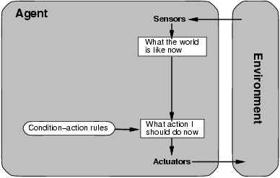
Simple reflex agents
Select action on current percept
Ignore percept history
Actions based on condition-action rule
Problems?? – works only in fully observable environment

Slide 21
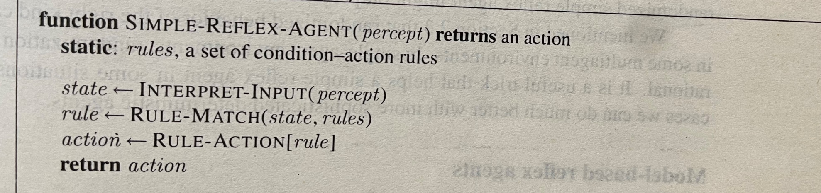
Simple reflex agents

Slide 22
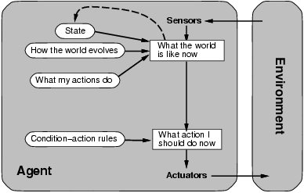
Model-based reflex agents
Keep track of current state of the world agent can’t see
Maintain an internal state that depends on percept history n reflect unobserved aspects
updating internal model requires knowledge about how the world evolves independent of the agent and how agent actions affect the world
Model of the world → knowledge about how the world , hence the name

Slide 23
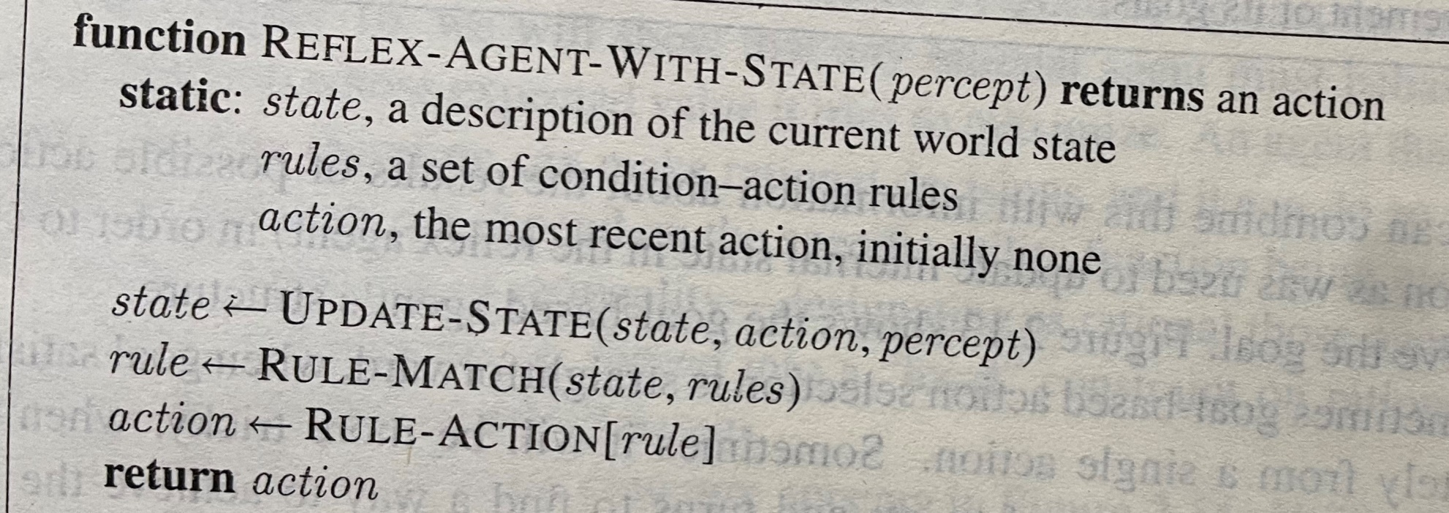
Model-based reflex agents

Slide 24
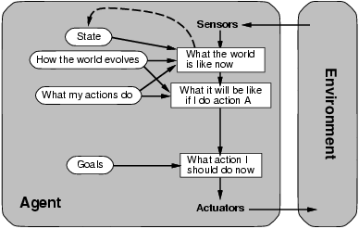
Goal-based agents
Keep track of current state of the world and set of its goals
Search and planning are required to achieve goals
Decision making involves consideration of future – what will happen and will I be happy
It is less efficient but more flexible s knowledge is explicit and can be modified
Agents behaviour can be changed to a different location

Slide 25
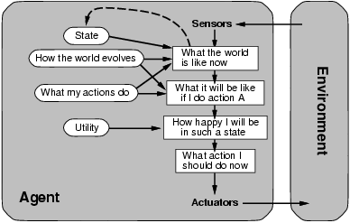
Utility-based agents
Goals alone are insufficient to generate high quality behaviour
Goals provide crude distinction between happy and unhappy state – need how happy
Instead higher Utility of agent is preferred
utility function maps a state to real number – degree of happiness
Allows rational decision where goal is inadequate : in conflicting goals and in selecting goals that can be achieved

Slide 26
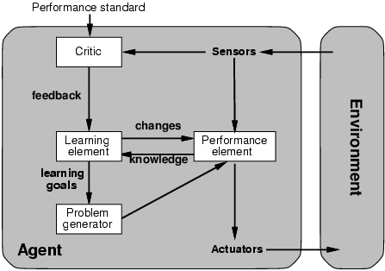
Learning agents
Learning allows agent to operate in initially unknown environment
Learning element : making improvements
Performance element : selecting external actions
Critic : provides feedback on how the agent is doing and determines how the performance element should be modified
Problem generator: suggesting actions

Slide 27
Conclusion
Agents can have variety of components
Each component can be presented in a variety of ways
A variety of learning methods but one unifying theme
Learning in intelligent agent is a process of modification of each component to bring them into a closer agreement with available feedback information thereby improving overall agent performance

